Slide 1

Game of Life
Solar Team
Natalia Solar

Slide 2
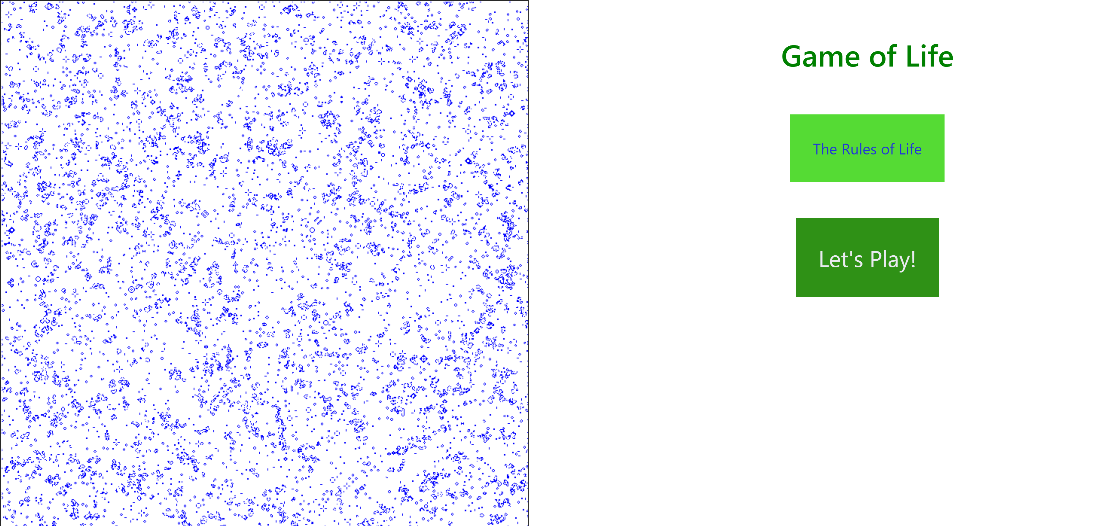

Slide 3
Game of Life
Javascript
-sets colors, font size, text align
-splits screen into 2 parts
-2 buttons with
dropdown blocks
CSS
HTML
-playTheGame()
*drawTheGrid()
*loops to apply rules
*detects keypresses
*requestAnimationFrame(playTheGame)
Project Description

Slide 4
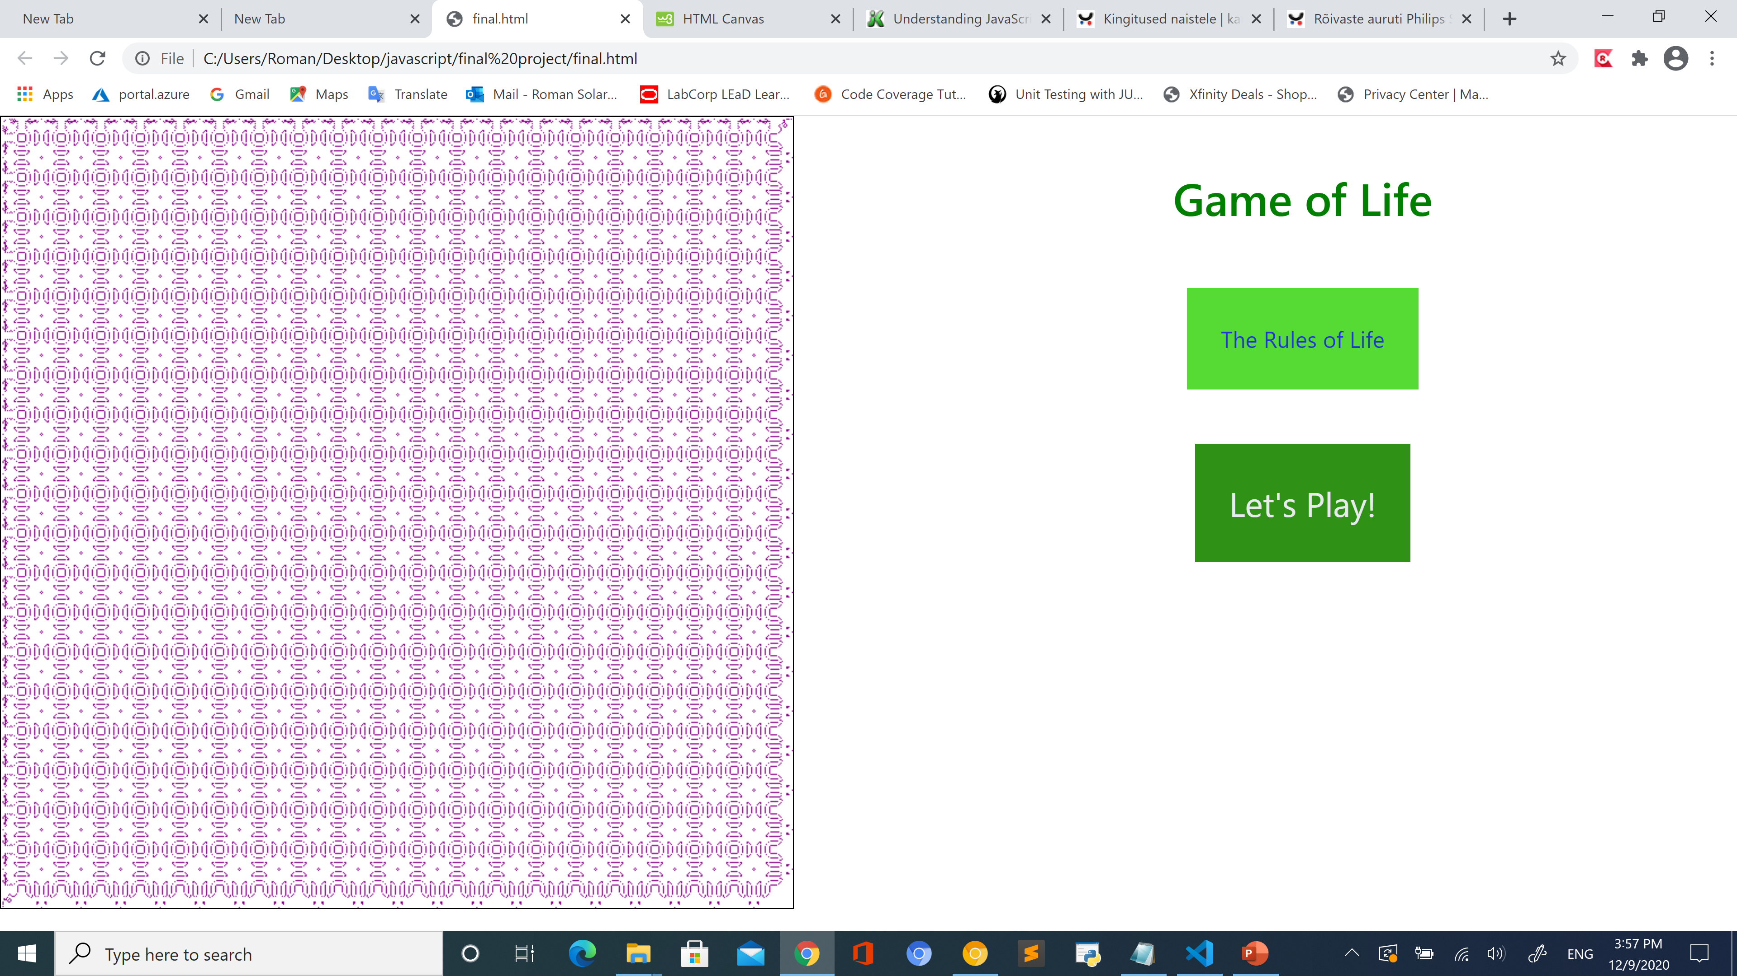
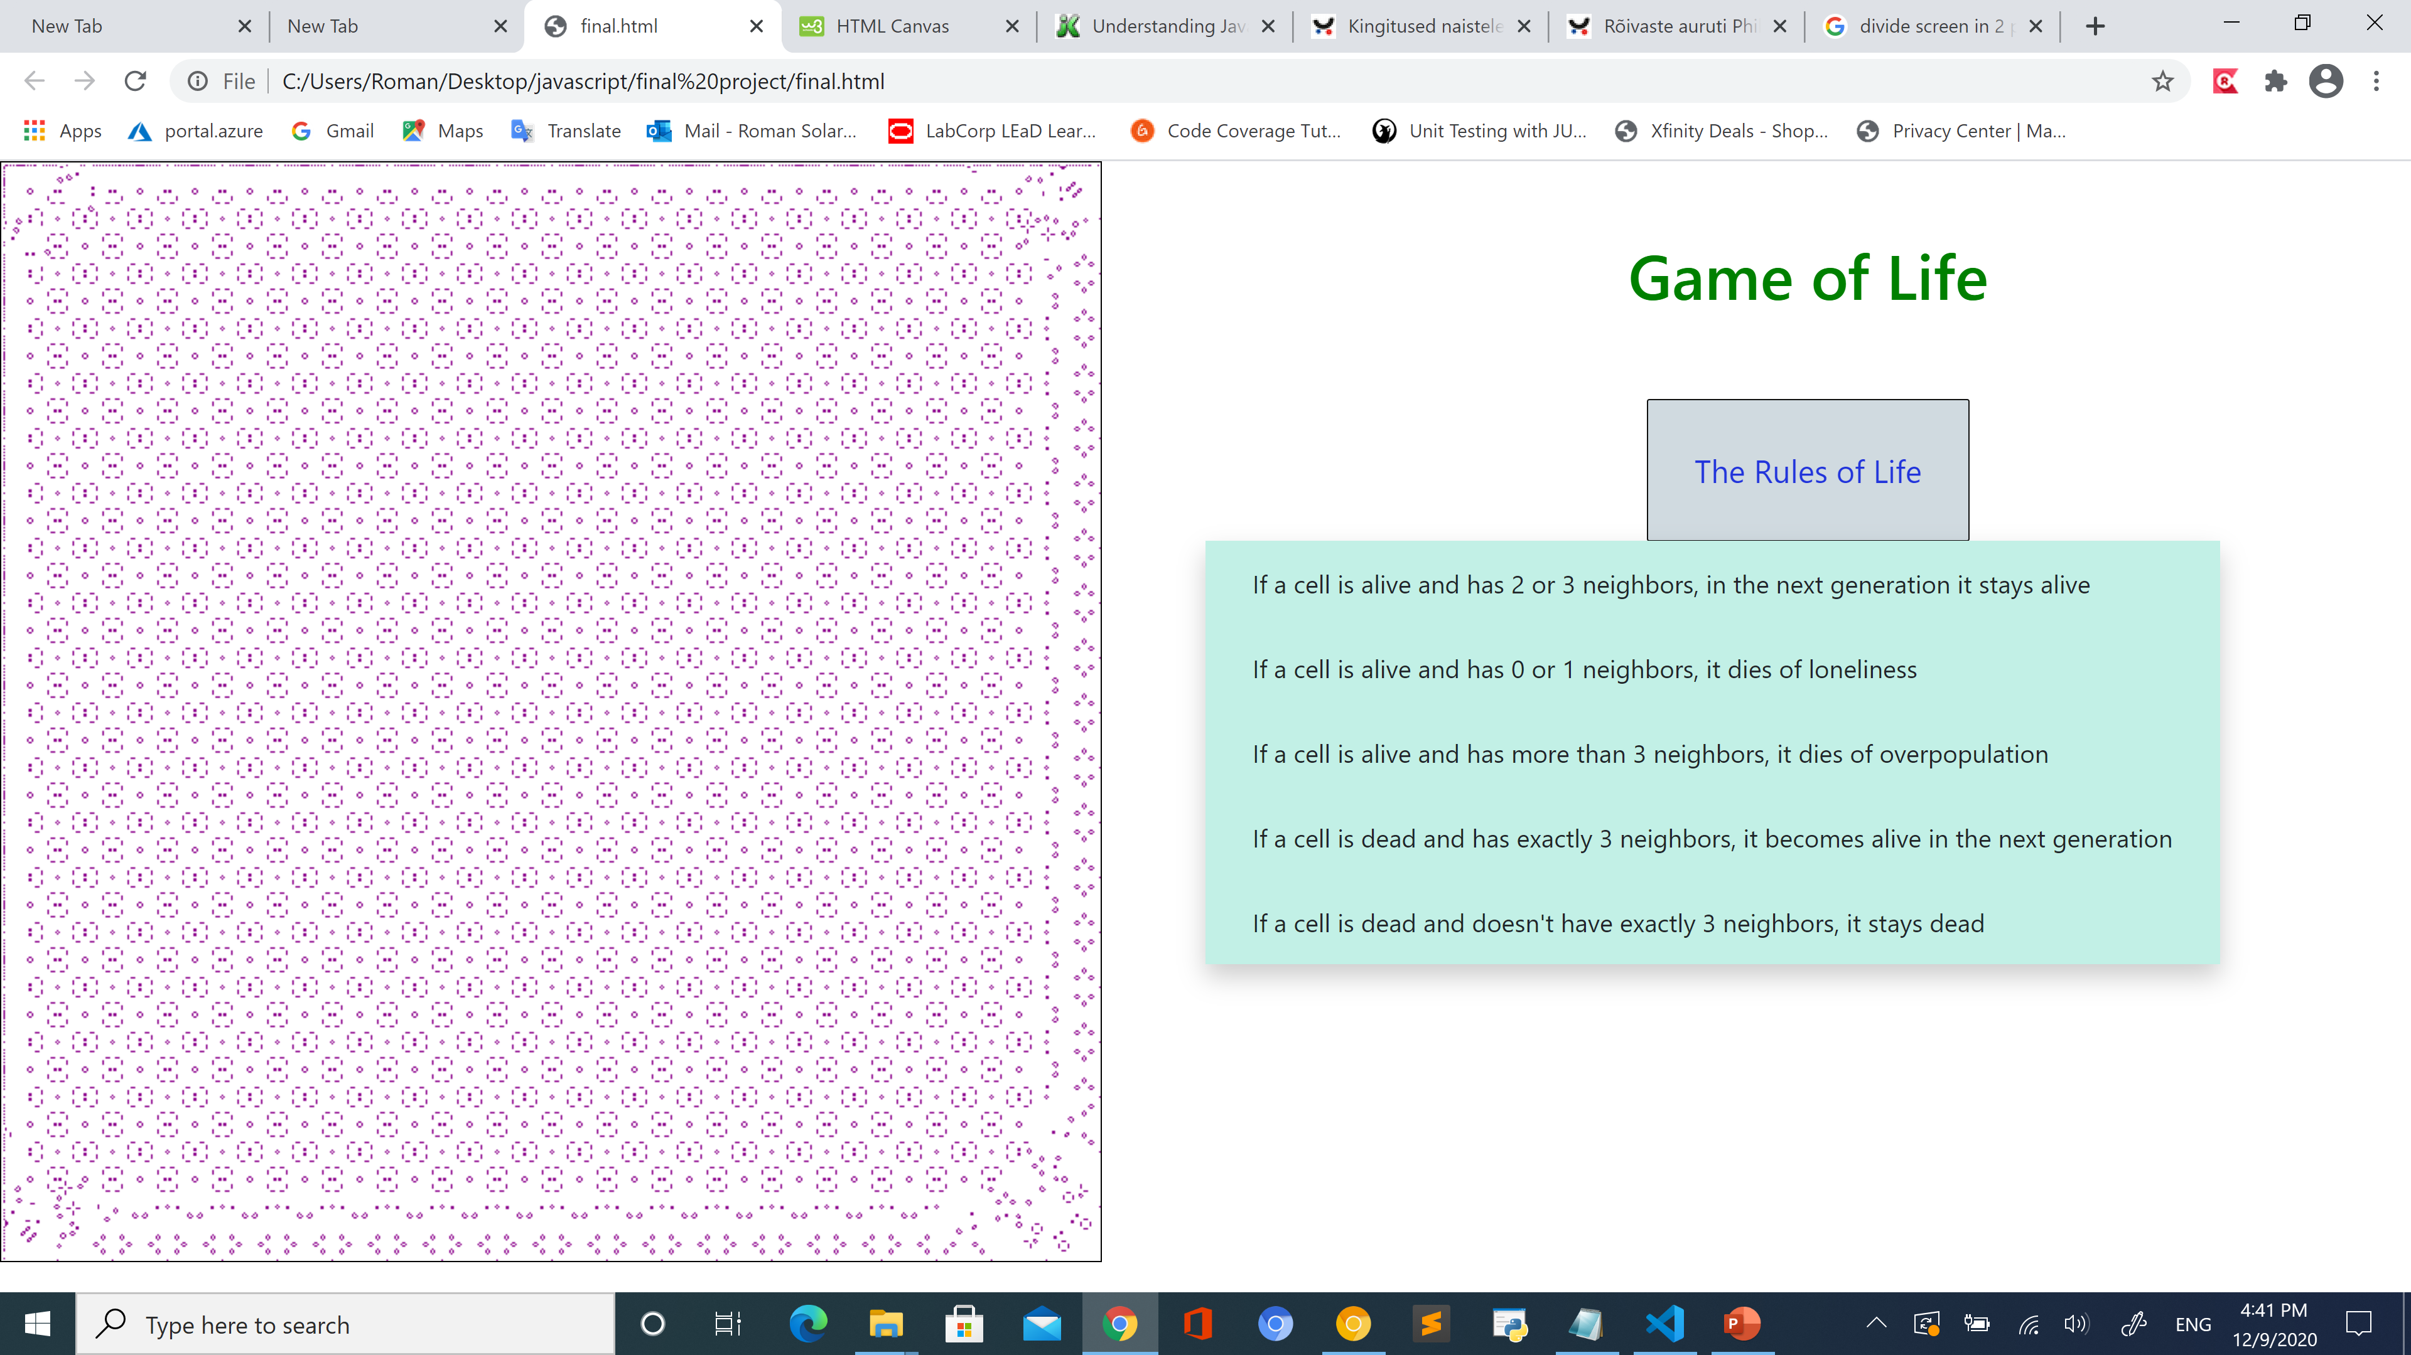
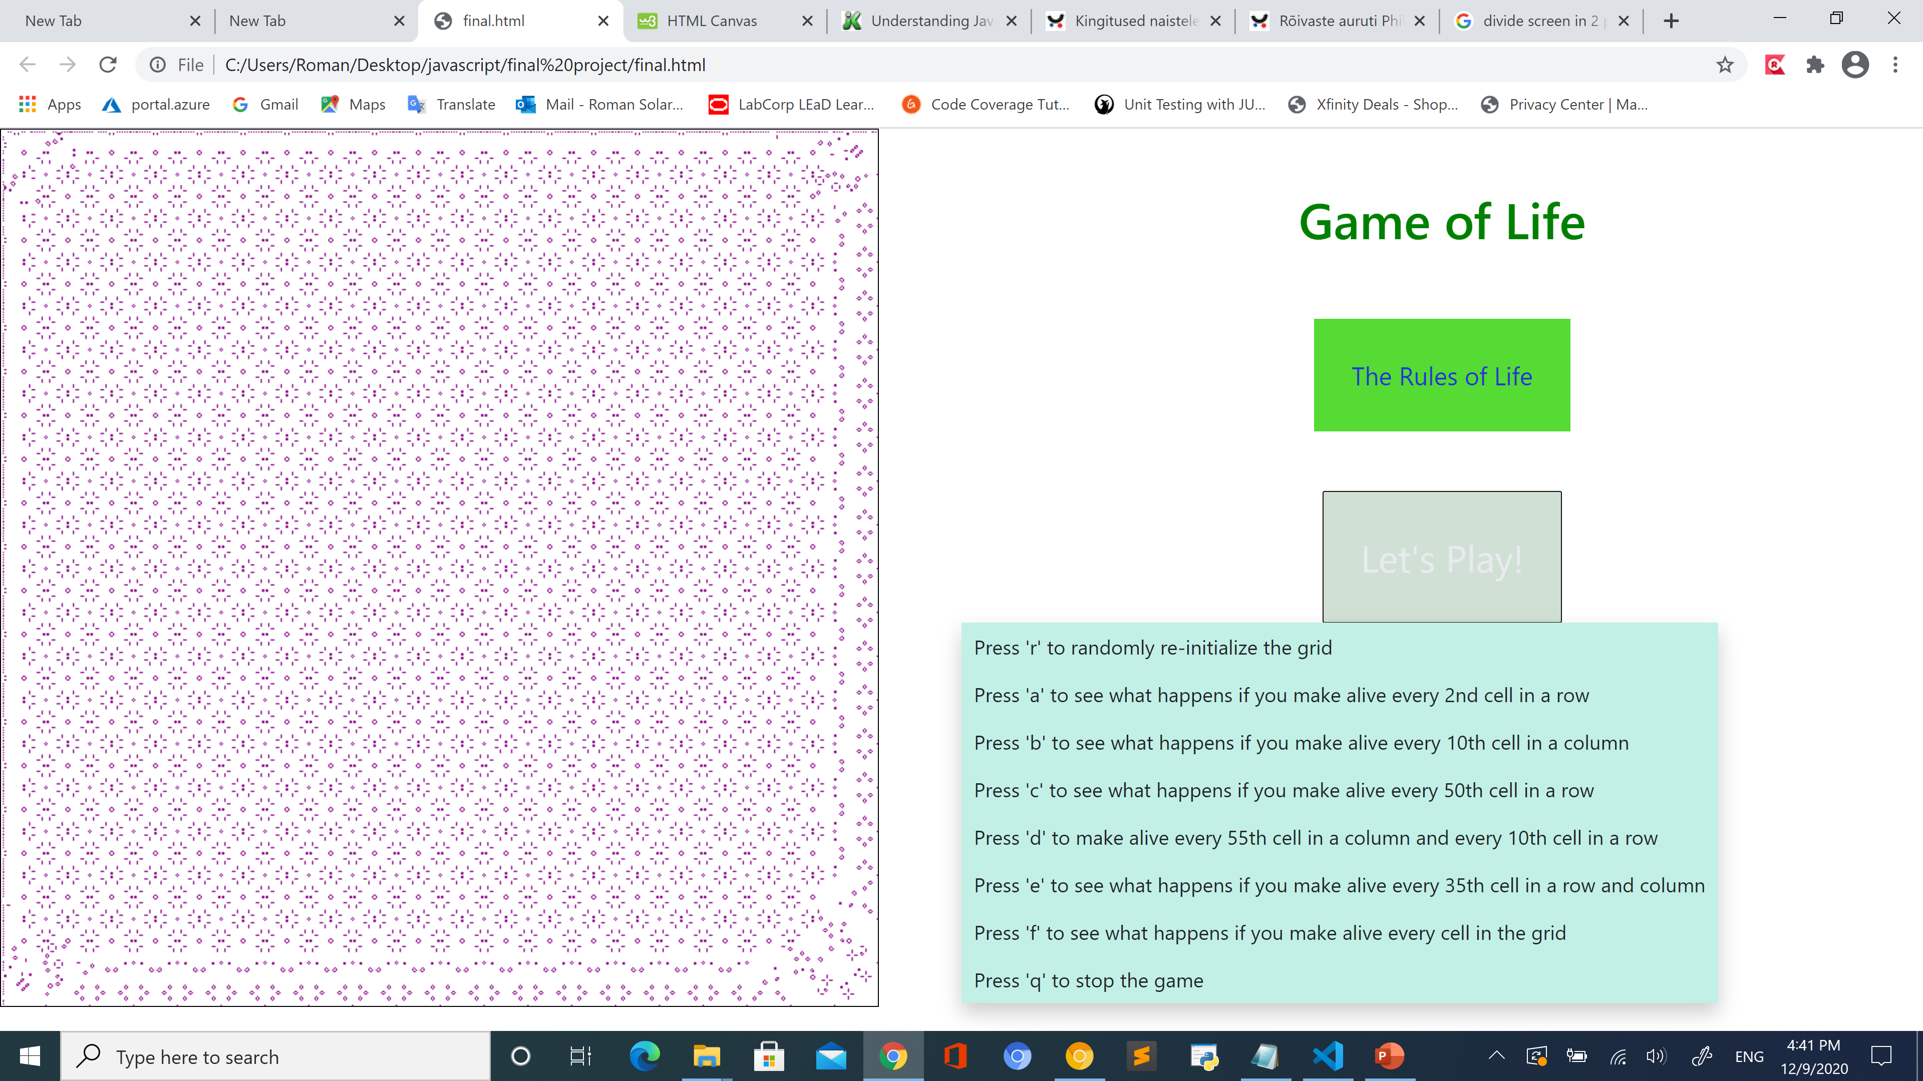
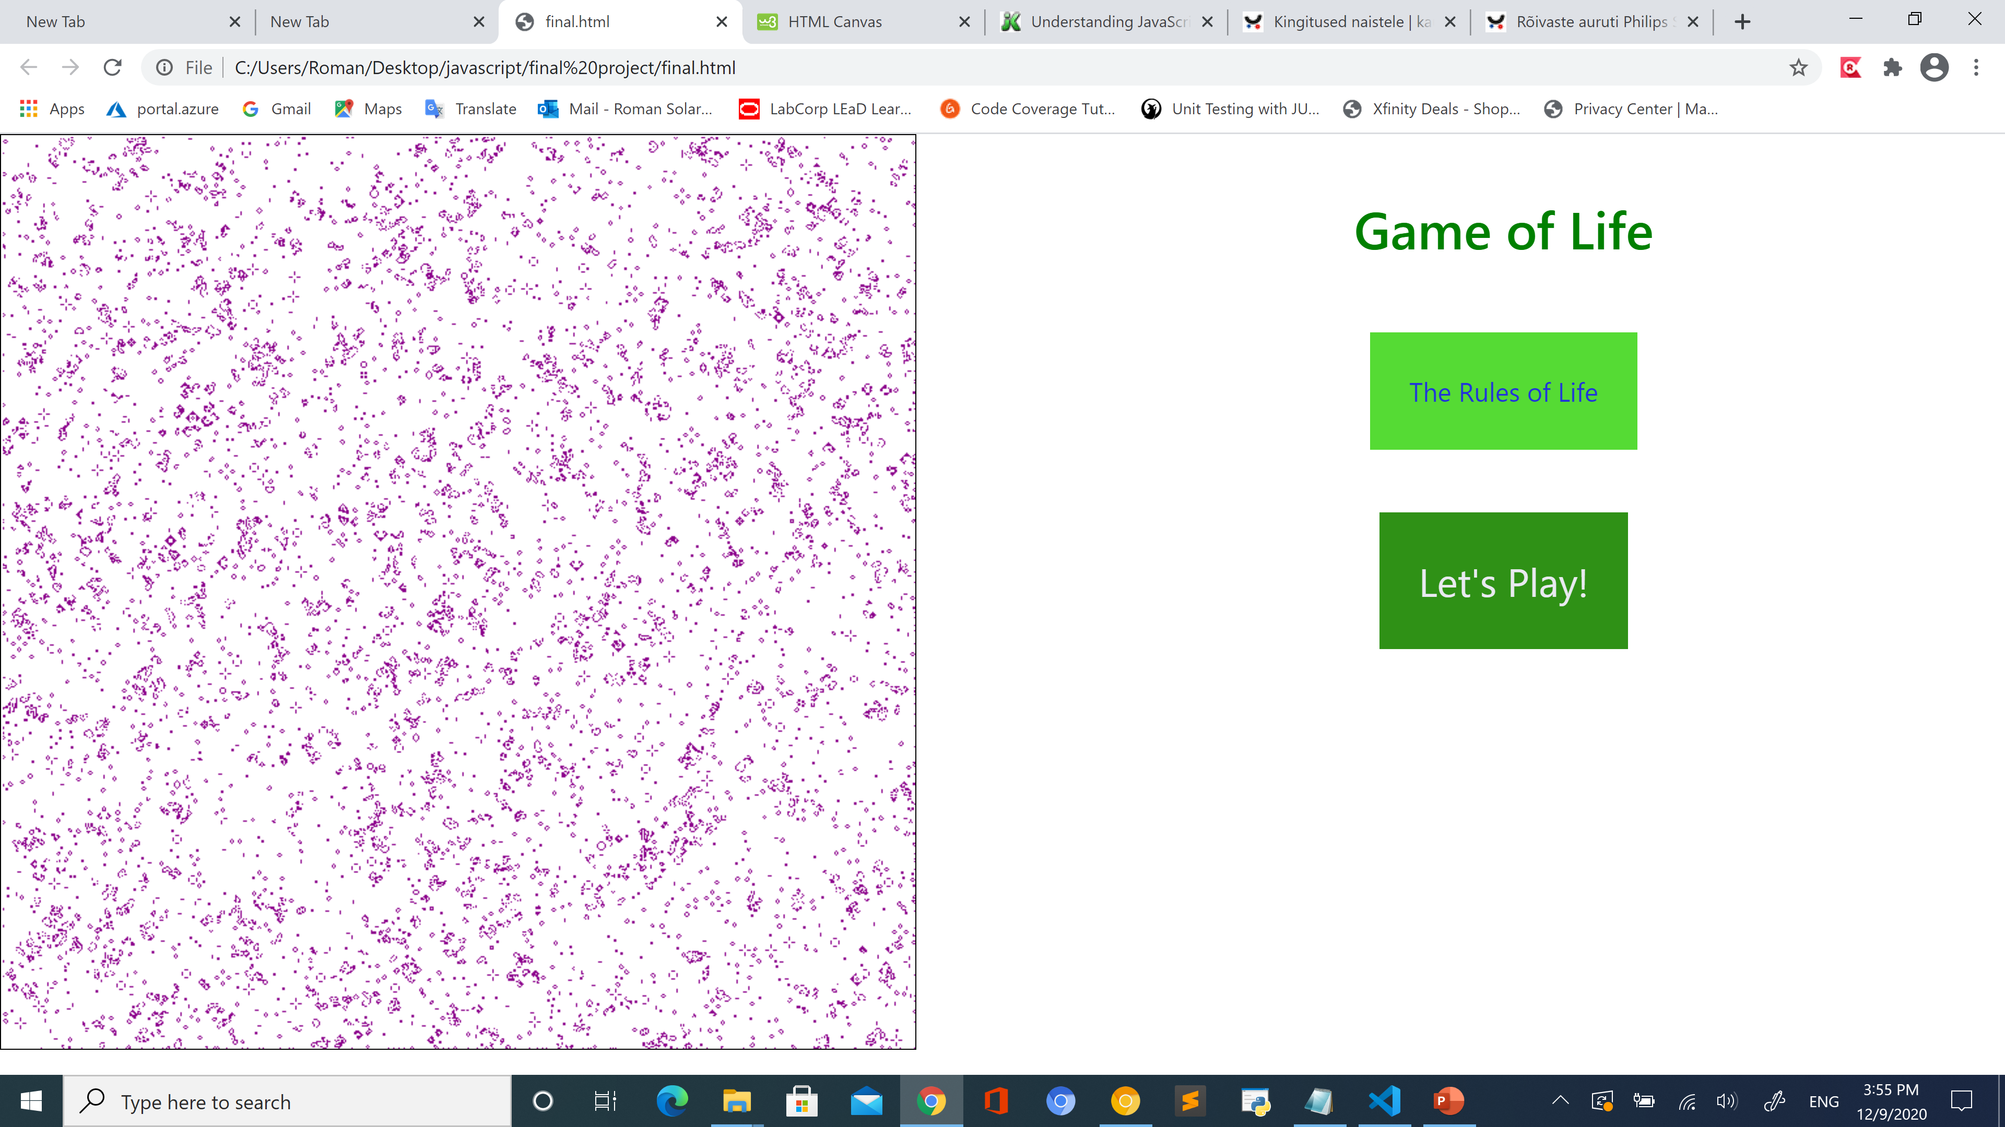

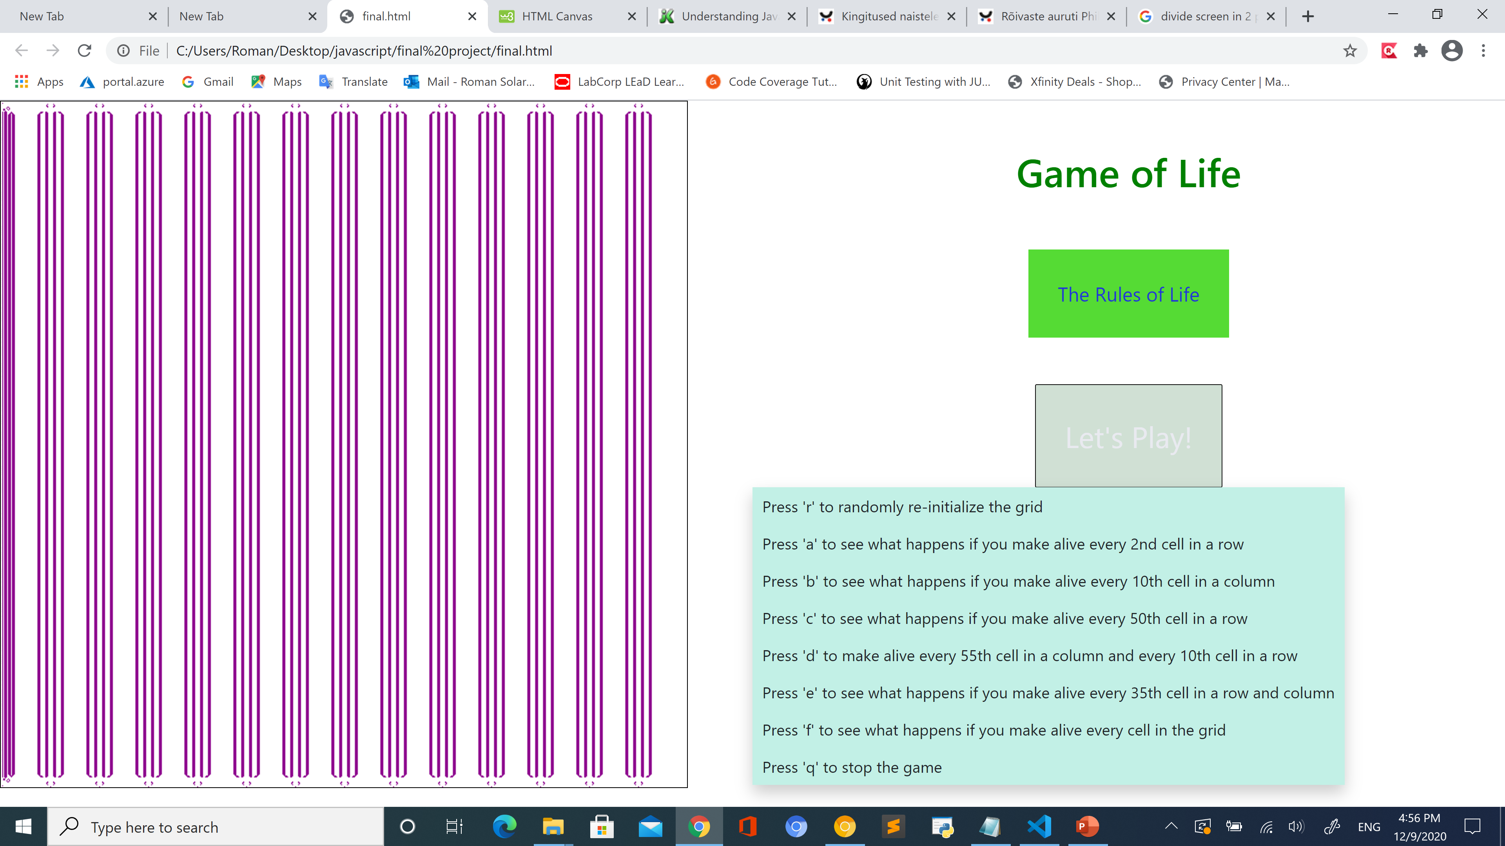
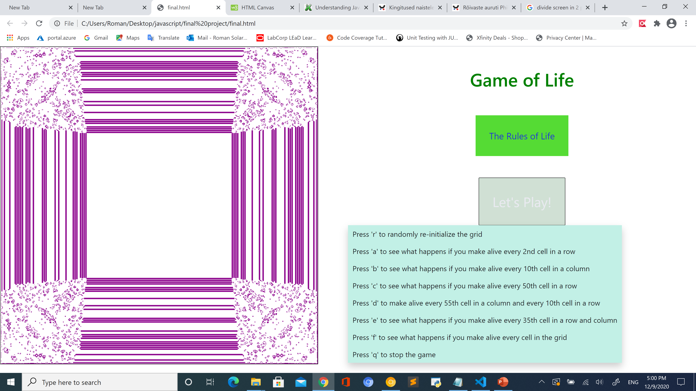
How to play

Slide 5
Thank You!

